Slide 1
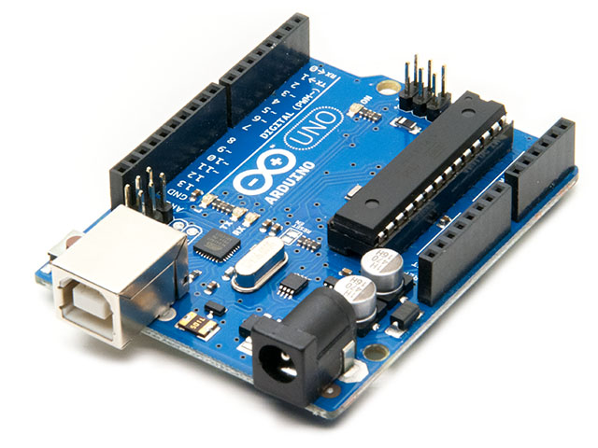
Control Systems Introduction
By Mhamad Salih

Slide 2
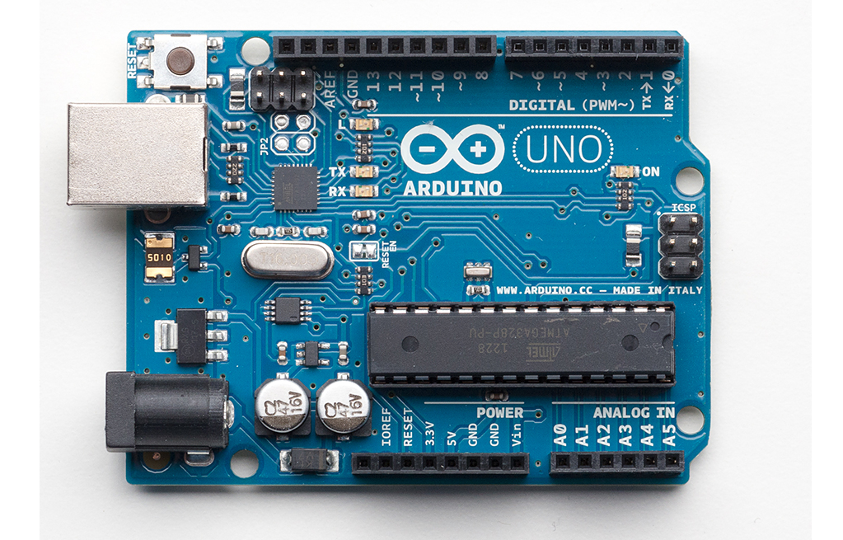
Basics of the Arduino
General Purpose I/O
LED
USB
Microcontroller
Power
Analog input

Slide 3
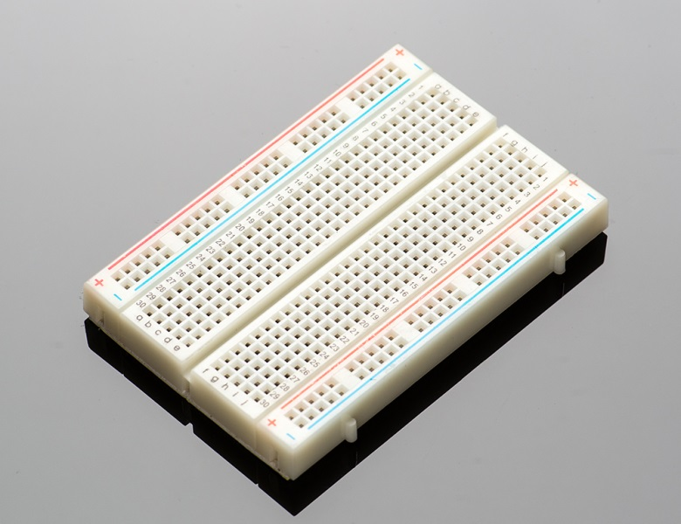
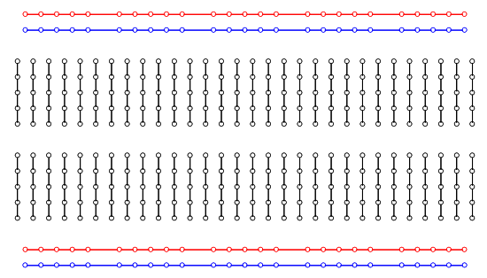
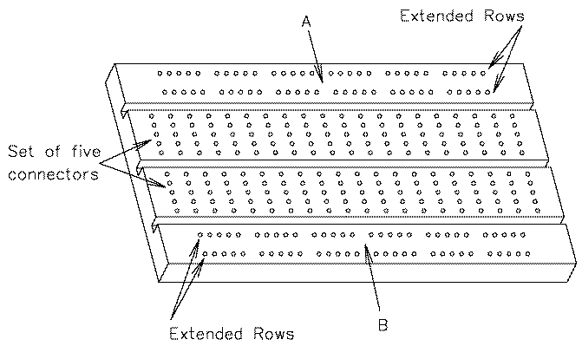
Breadboard Basics

Slide 4
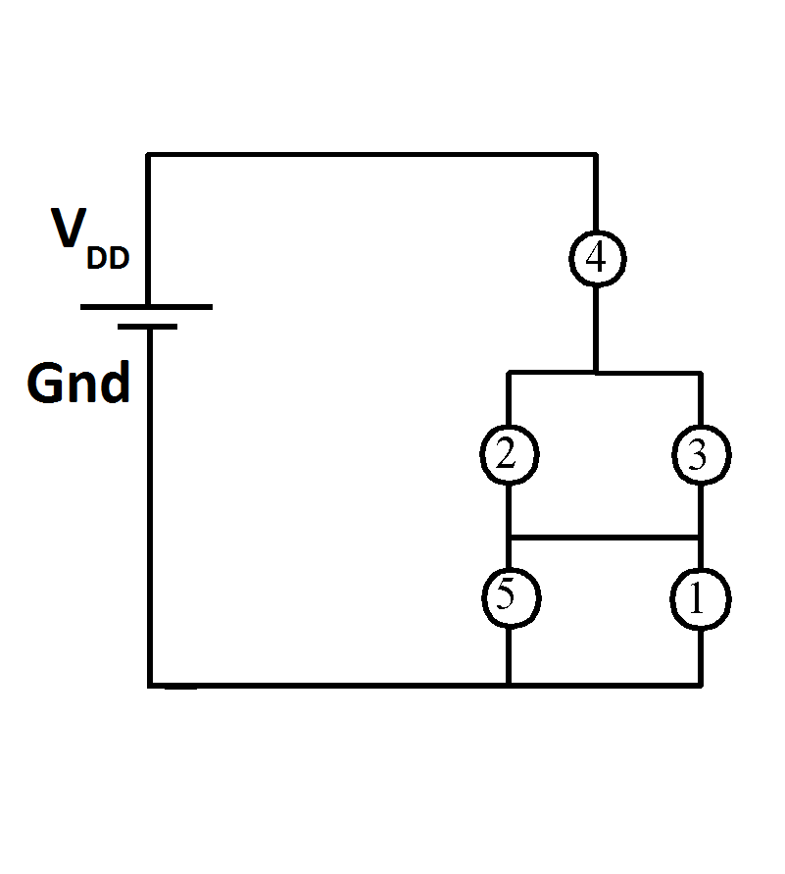
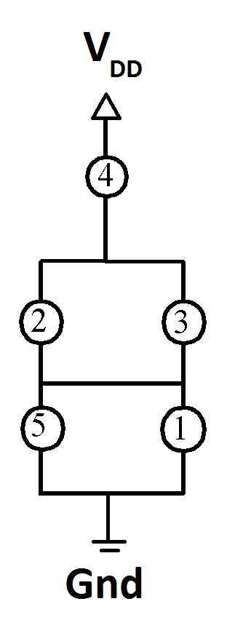
Electrical Eng. circuit Convention

Slide 5
Electronic safety
Do not place Arduino over conductive surfaces
Do not connect 5V directly to 0V (Ground)
Wire up the circuit before powering the Arduino
Do not disconnect parts of a circuit when the Arduino is powered (unplug it first!)
Failure to meet these rules will result in a smoke-like gas escaping the Arduino that smells like smoke.

Slide 6
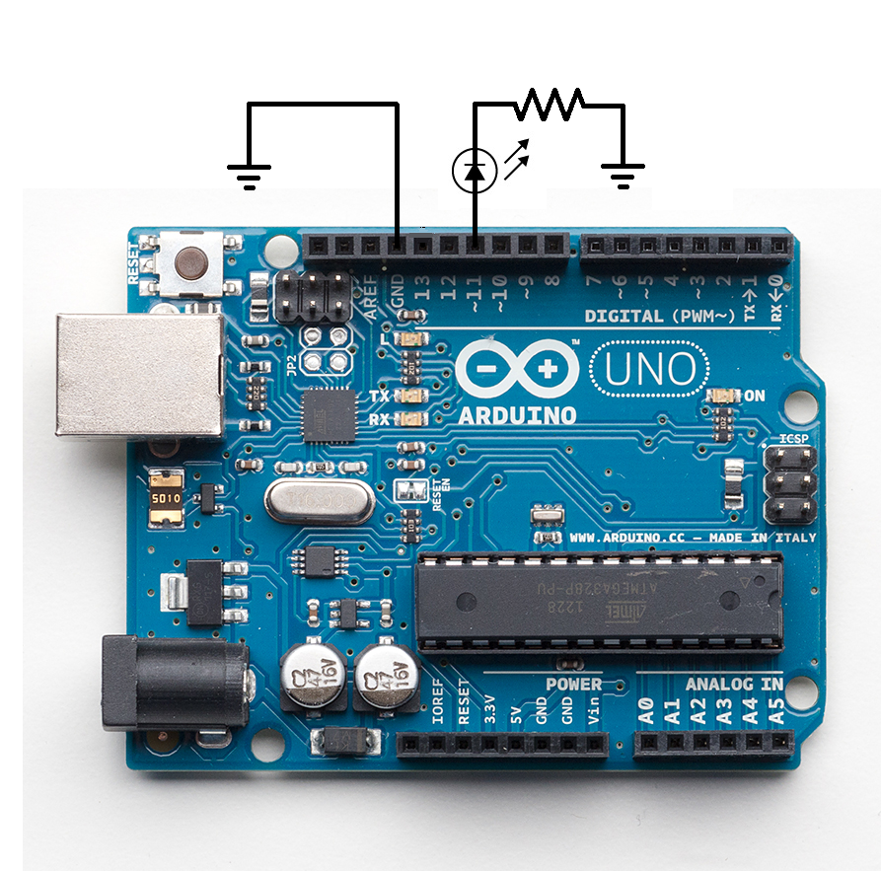
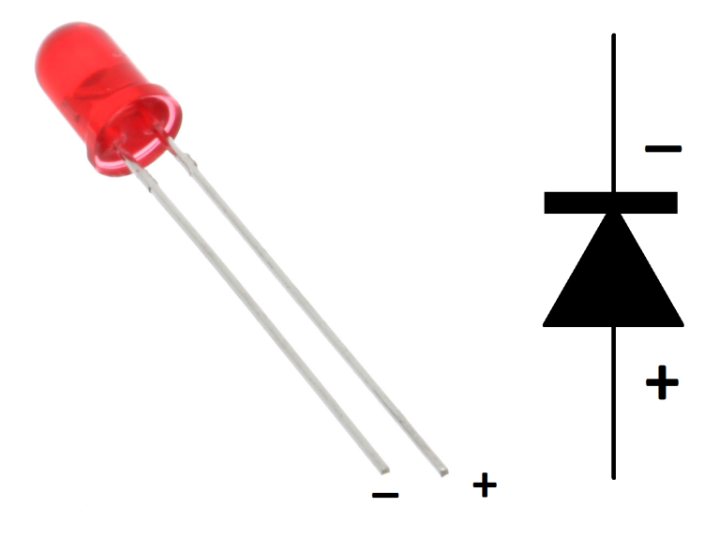
Output & blinking an LED

Slide 7

Pulse Width Modulation
A method for providing variable voltage levels using only 0V and 5V

Slide 8
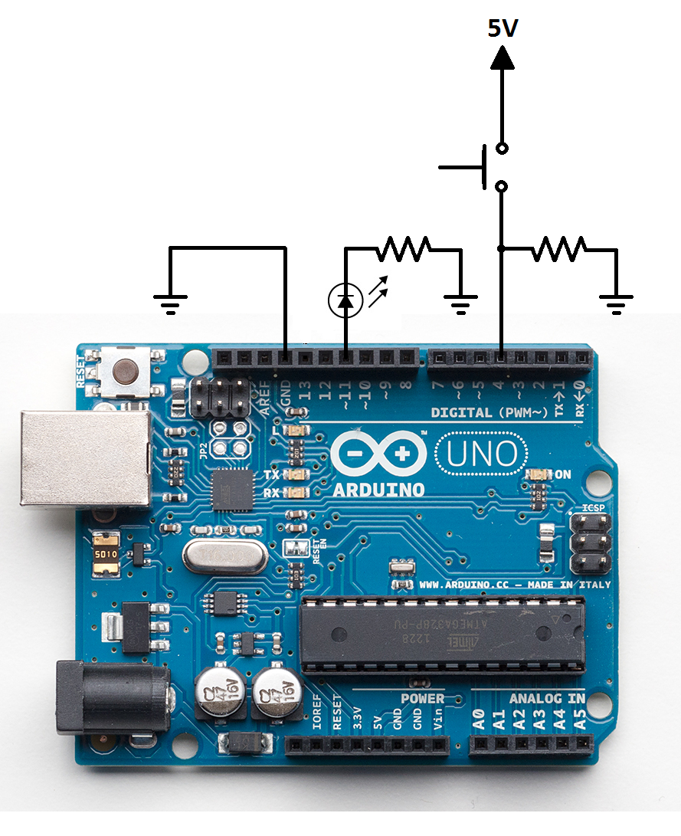
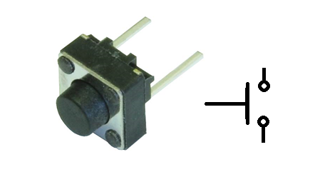
Inputs
Pull down resistors ensure that the value on an input pin is 0V when it isn’t 5V. Without a pull down, the value would be floating (any where between 0 and 5V) and result in measurement error.

Slide 9
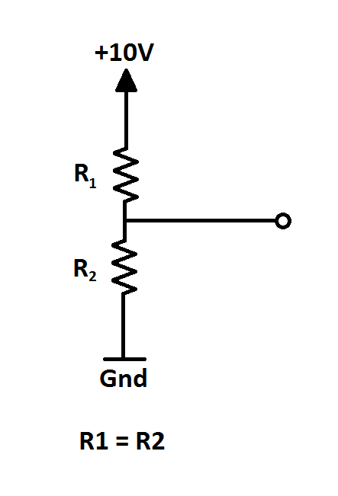
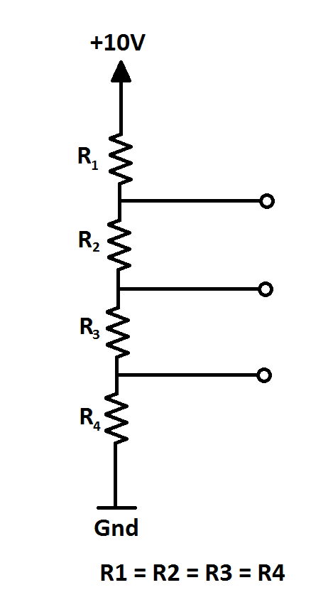
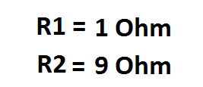
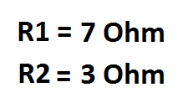
Voltage Divider

Slide 10
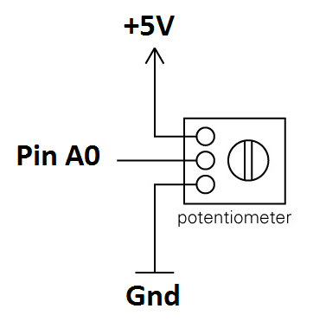
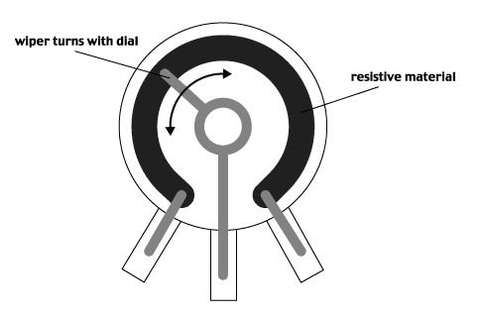
Potentiometer: A variable voltage divider

Slide 11
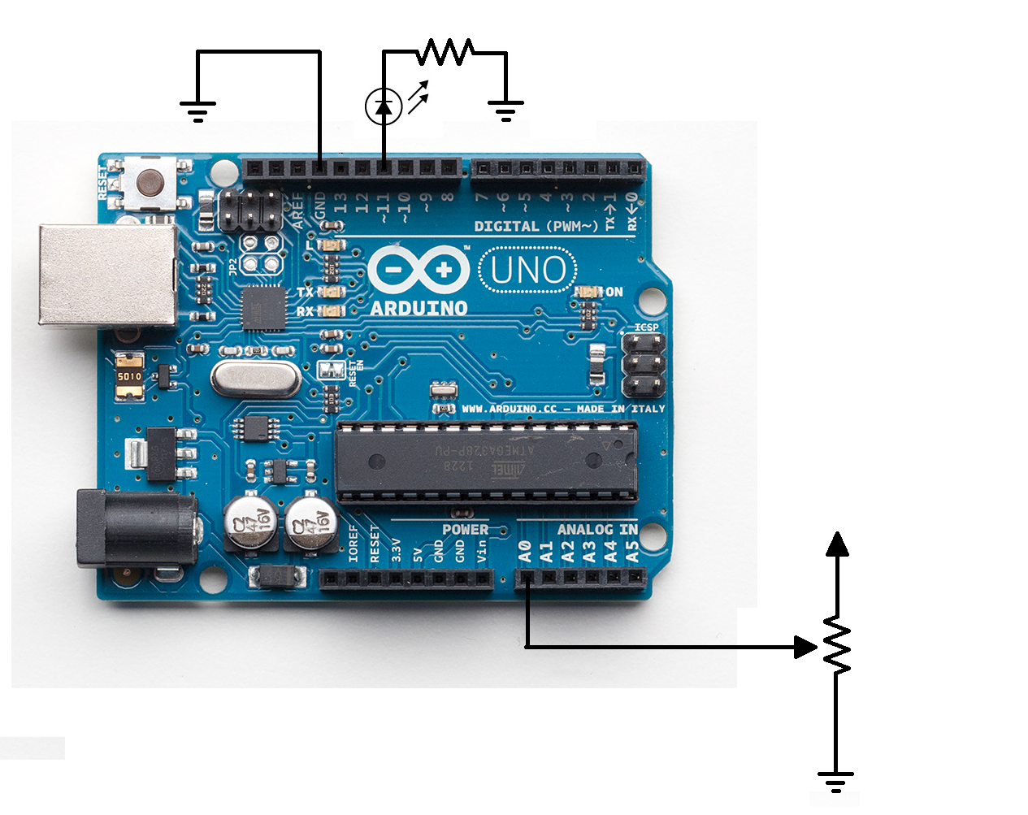
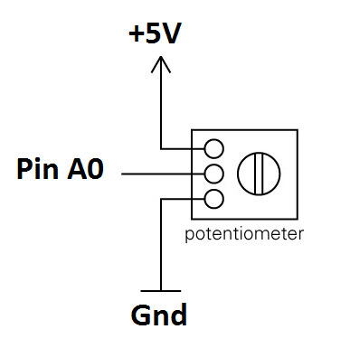
Analog Input &Serial Data transfer

Slide 12
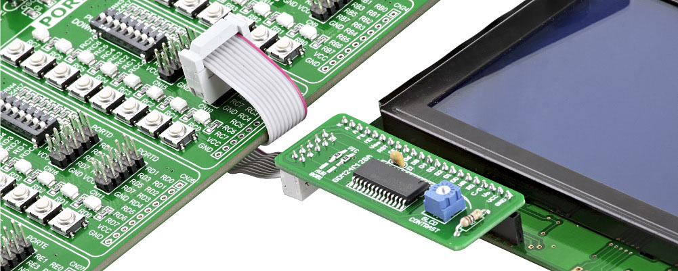
Advanced control systems: Communication Protocols with an Arduino

Slide 13
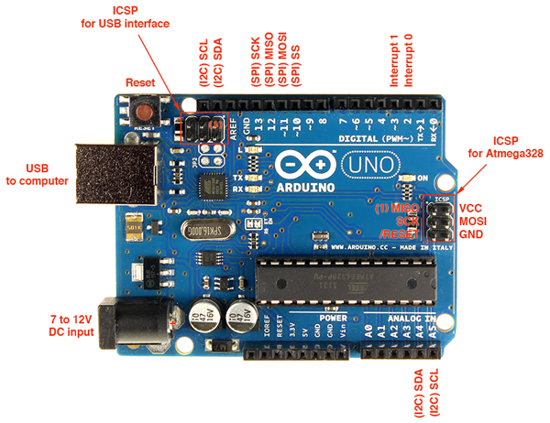
Communication Protocols: SPI and I2C

Slide 14
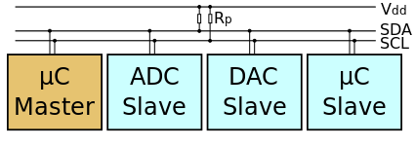
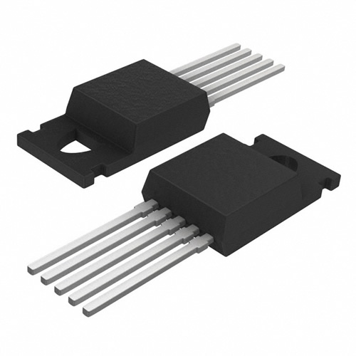
Inter-Integrated Circuit: I2C
Allows a master (Arduino) to talk to multiple slaves.
Each slave has its own ID number, this lets the master know which slave it is communicating with.
The slave does as the master demands.
We will be using a temperature sensor as our slave.

Slide 15
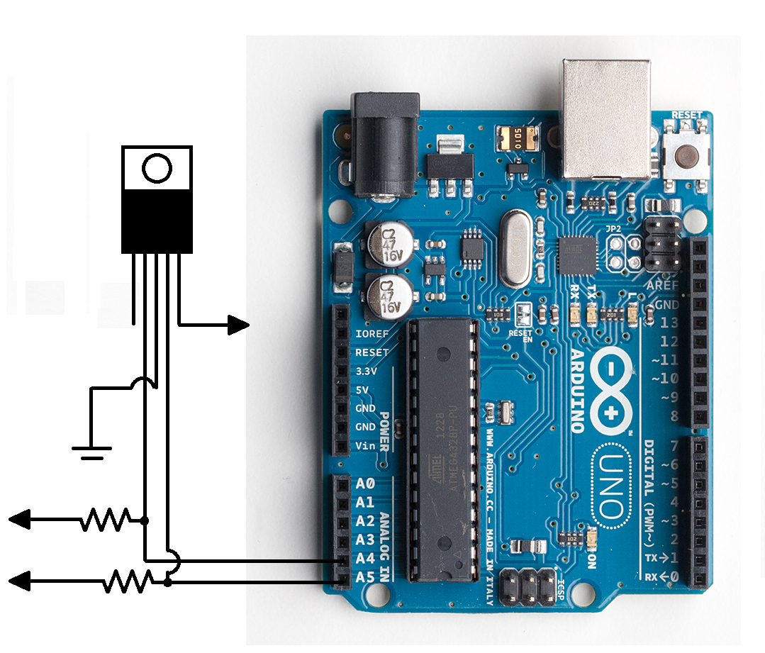
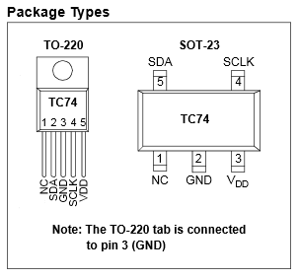
I2C communication with a temperature sensor

Slide 16
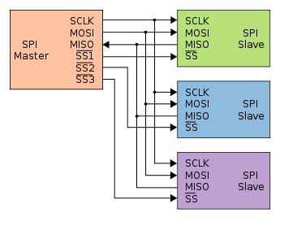
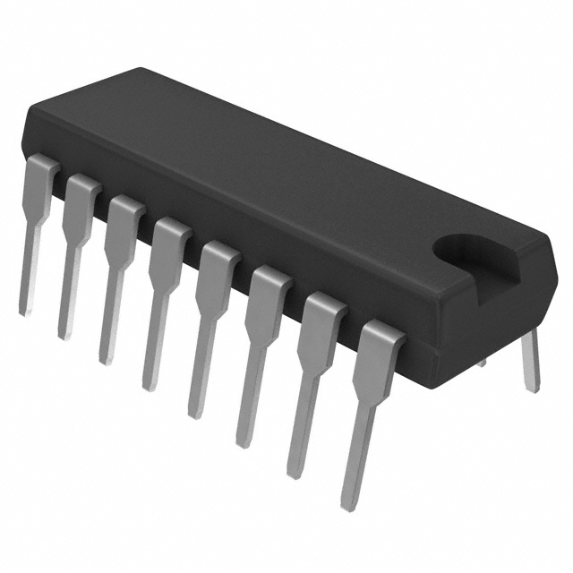
Serial Peripheral Interface
Allows the master to communicate with its slaves in two methods; typical SPI bus and Daisy chained SPI bus.
Does not require pull up resistors.
We will focus on the typical SPI bus method.
We will be using a single slave, an LED driver.

Slide 17
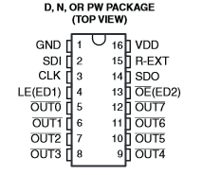
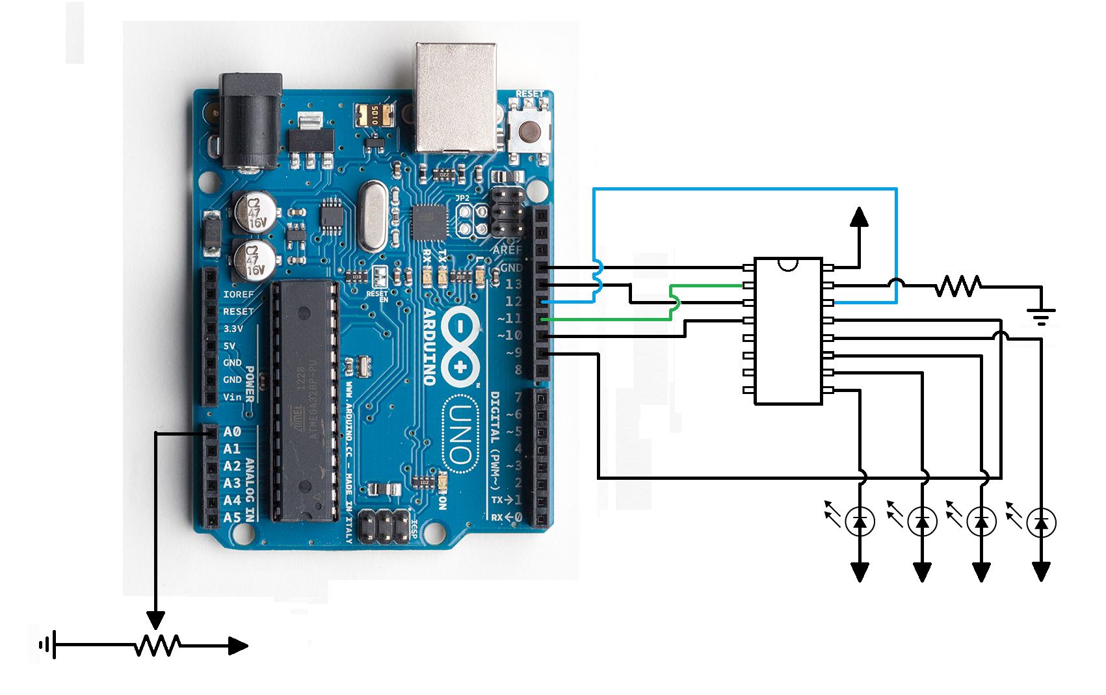
SPI communication with an LED driver

Slide 18
Summary of what you’ve learned
Programed inputs and outputs
Used an ADC to read in Analog values, and process the data to make useful information (binary -> voltage)
Sent serial data back to a computer for debugging
Used I2C and SPI protocols to communicate with Integrated Circuits (ICs)

Slide 19
What should I do next?
If you found this an interesting tutorial, I recommend you buy yourself an Arduino (Ebay, Adafruit etc..) and play around with it
Put an effort to learn about the different types of ICs out there and how they communicate with each other
Learn about PIC microcontrollers and how they are programmed (Slightly more complicated than Arduinos), we use PIC MCUs for most of our circuits at Solar car.

Slide 20
Thank you, come again!

